Slide 1
SCC204 Software Design
Design Pattern-Principle
Zhang Jinyu
zjy@bjtu.edu.cn

Slide 2
In the lectures about Software Design...
Key objectives for software design
Flexibility, reusability, correctness, robustness, efficiency
Design object-oriented software that supports two particular design objectives: flexibility and reuse

Slide 3
Today’s Focus
What are design patterns?
Design patterns:
Observer
Singleton
Adapter

Slide 4
Learning outcomes
After studying today’s material, you should be able to:
Describe what design patterns are
Describe the Observer/Singleton/Adapter design patterns and their consequences, and apply the patterns

Slide 5
Recap
扩展性
Reuse and flexibility are two important design objectives
Designing software in terms of classes that can be reused in other applications contributes to a reduction in software development costs
Flexibility is concerned with accommodating change throughout a software system’s lifetime

Slide 6
A library system example
Lendable {abstract}
Borrower
name : String
name : String
0..5
0..1
isOnLoan( ) : boolean
checkOut( b : Borrower ) : boolean
checkIn( )
getBorrower( ) : Borrower
isOverdue( ) : boolean {abstract}
getFine( ) : int {abstract}
borrow( l : Lendable ) : boolean
return( l : Lendable )
getAcruedFine( ) : int
Book
Journal
Video

Slide 7
Implementation
public abstract class Lendable {
private String name;
private Borrower borrower;
private Calendar dateBorrowed;
public boolean isOnLoan( ) {
return borrower != null;
}
public boolean checkOut( Borrower b ) {
boolean success = false;
if( ! isOnLoan( ) ) {
success = true;
borrower = b;
dateBorrowed = Calendar.getInstance( );
}
}
public void checkIn( ) {
borrower = null;
dateBorrowed = null;
}
public Borrower getBorrower( ) {
return borrower;
}
public abstract boolean isOverdue( );
public abstract int getFine( );
}
Designed to be reused

Slide 8
Implementation
public class Book extends Lendable {
public boolean isOverdue( ) {
OurDate dateLoaned = new Date( dateBorrowed.get( Calendar.YEAR ),
dateBorrowed.get( Calendar.MONTH ),
dateBorrowed.get( Calendar.DAY ) );
Calendar now = Calendar.getInstance( );
OurDate today = new OurDate( now.get( Calendar.YEAR ),
now.get( Calendar.MONTH ),
now.get( Calendar.DAY ) );
if( OurDate.subtract( dateLoaned, today ) > 28 )
return true;
else
return false;
}
…
}
-
Reuse

Slide 9
What are Design Patterns?
Software developers encounter problems of a similar type when developing all sorts of software
Solutions to these problems are also similar across various types of applications, reuse of these solutions
Common vocabulary used for efficient communication between developers
“Let’s use the Adapter pattern to ….”
Patterns of problems
Patterns of solutions

Slide 10
Design Patterns: History
Since 1990 Object-oriented patterns in software engineering
1995 Gang of Four (Gamma, Helm, Johnson, Vlissides): Design Patterns: Elements of Reusable Object-Oriented Software
creational (Singleton), structural (Adapter), behavioural (Observer)
Design Patterns in Java (William Wake, Steven Metsker, 2006, 2nd edition); Patterns in Java (Mark Grand, 2001, 3rd edition)
单继承
适配器

Slide 11
Design Patterns: Structure
Name of the pattern
Description of the problem that can be fixed when using the pattern
Example of use
Description of the solution
Textual, diagram (UML), source code
Discussion of advantages / disadvantages

Slide 12
Design Patterns: Gang of Four
Creational
Class instantiation
Abstract Factory, Builder, Factory Method, Prototype, Singleton
Structural
Class and Object composition
Adapter, Bridge, Composite, Decorator, Façade, Flyweight, Proxy
Behavioural
Communication between objects
Chain of responsibility, Command, Interpreter, Iterator, Mediator, Memento, Observer, State, Strategy, Template method, Visitor
不兼容

Slide 13
Behavioural: Observer Pattern
Observers
Subject
Subject is independent from the observers
Observers are dynamically assigned to the subject
Subject informs observers about its state changes
不同人采取不同策略

Slide 14

Behavioural: Observer Pattern
Subject
Observers
数据变化
Subject is independent from the observers
Observers are dynamically assigned to the subject
Subject informs observers about state changes

Slide 15
Behavioural: Observer Pattern
Also known as “publish/subscribe”
Observe the state of an object
1 (subject) : n (observer) – relationship between objects
Subject changes state → observers are informed
Used by Model View Controller paradigm
Behavioural design pattern: Communication between objects

Slide 16
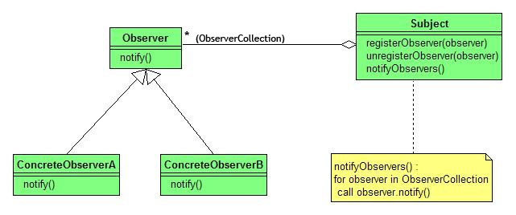
Behavioural: Observer Pattern
http://en.wikipedia.org/wiki/Observer_pattern

Slide 17
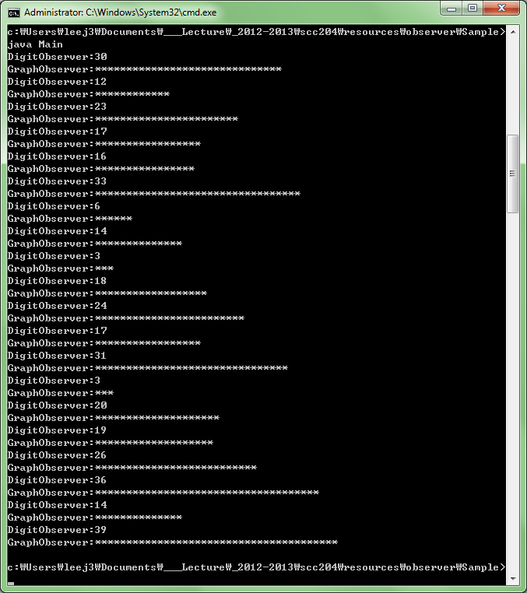
Exercise: Number Generator

Slide 18
Main.java
public class Main {
public static void main(String[] args) {
NumberGenerator generator = new RandomNumberGenerator();
Observer observer1 = new DigitObserver();
Observer observer2 = new GraphObserver();
generator.addObserver(observer1);
generator.addObserver(observer2);
generator.execute();
}
}
1) ________________________
2) ________________________
3) ________________________
4) ________________________

Slide 19
Creational: Singleton Pattern
Situations where you need only one object of a class
Security Manager
All security must be handled by a single object
Cannot have more than one object managing security
Creational design pattern: Class instantiation

Slide 20
Creational: Singleton Pattern
First instantiation
Singleton class
Object of singleton class
Subsequent
instantiations

Slide 21
Creational: Singleton Pattern
static 一个类只有一个实例
public class Singleton {
private static final Singleton INSTANCE = new Singleton();
// Private constructor prevents instantiation from other classes
private Singleton() {
}
public static Singleton getInstance() {
return INSTANCE;
}
}
http://en.wikipedia.org/wiki/Singleton_pattern

Slide 22
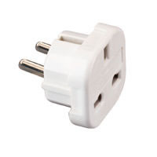
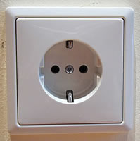
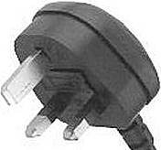
Structural: Adapter Pattern
考试题：适配器模型
Let’s look at one specific design pattern and its implementation
German socket
Adapter
UK plug
一个对象转换为另一个对象

Slide 23
A design problem
A key component of JDK is the AWT (Abstract Windowing Toolkit) framework
Like any framework, the AWT is a collection of classes and interfaces that are designed to be extended to meet application-specific needs
A particular challenge is how to provide a set of reusable GUI classes (e.g. Button, Menu, Label, TextField etc.) and keep them independent of any particular application

Slide 24
Solution
processActionEvent(): Processes action events occurring on this button by dispatching them to any registered ActionListener objects.
actionPerformed(): Invoked when an action occurs.
考试可能会考
Button
processActionEvent( e : ActionEvent )
addActionListener( l : ActionListener )
processActionEvent( e : ActionEvent )
实现perform
重写calculate
Framework
Adaptation
Reuse
<< interface >>
ActionListener
MyActionListener
LoanCalculator
actionPerformed( event : ActionEvent )
calculate( )
继承类
实现接口

Slide 25
The alternative to adaptation
Without using any form of adapter, you could edit the source code for an existing class (e.g. LoanCalculator) and make it implement the necessary interface (e.g. ActionListener)
This is not so attractive:
It means fiddling with LoanCalculator’s source code which could introduce bugs into the LoanCalculator class
You may not have the source code for LoanCalculator in any case
Do you rebuild every socket in a foreign country / electronic device or do you use an adapter?

Slide 26
Design objectives fulfilled
Adaptation contributes to meeting the following design objectives:
Flexibility
Frameworks can be developed which will work with unanticipated classes
Reusability
Existing classes that implement useful functionality can be reused
Robustness
As a consequence of reusability, existing classes are reused without modification. This avoids the potential to introduce bugs

Slide 27
Observation
A Button object maintains a list of references to “ActionListener objects”
An ActionListener object is any object whose class implements the ActionListener interface
A Button object can thus interoperate with an instance of any class that implements ActionListener
button是一个接口不是类
Button commits to an interface (ActionListener) and not a specific class.
This is a fundamental rule for designing object-oriented software.

Slide 28
What if ...
What if the designers of the JDK made ActionListener a class rather than an interface
button
ActionListener
LoanCalculator
actionPerformed( )
calculate( )
❒
问题：多继承
The Java language supports single inheritance (i.e. a Java class has at most one superclass).
MyActionListener
适配器
When designing frameworks, it’s best to provide interfaces that must be implemented, rather than classes that must be subclassed.
There is no reason for ActionListener to be a class – it has no interesting state to inherit and it has no default behaviour.

Slide 29
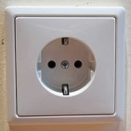
The Adapter design pattern
A
B
C
Intent
Convert the interface of a class (A) into another interface (B) clients (C) expect.
Adapter lets classes work together that couldn’t otherwise because of incompatible interfaces
Use the Adapter pattern when
You want to use an existing class, and its interface does not match the one you need
You want to create a reusable class that cooperates with unrelated or unforeseen classes
Structural design pattern: Class and Object composition
兼容
类和对象的组装
Notes:
Applicability:
Class calculator
Class Button

Slide 30
Class adapter
考试题：类适配器和对象适配器的区别
Class adapter
Adapter adapts Adaptee by inheriting from it and implementing the Target interface
Adapter通过继承Adaptee并实现Target接口来适应Adaptee
ActionListener
Client
<<Interface>>
Adaptee
Calculator
Target
Button
specificRequest()
request()
实现
MyActionListener
Adapter
public void request() {
specificRequest()
request()
}
适配者

Slide 31
Object adapter
Object adapter
An object adapter relies on object composition
Adapter inherits the Target interface and contains the Adaptee to which it forwards requests
对象适配器依赖于对象组合。
适配器继承Target接口，并包含它将请求转发到的Adaptee
ActionListener
Button
Client
Target
Adaptee
Calculator
specificRequest()
request()
?
?
Adapter
public void request() {
?
adaptee
adaptee.specificRequest ();
MyActionListener
request()
}

Slide 32
Applying Design Patterns
Applying design patterns is hard!
Don’t fall into the “design patterns trap”:
“I need to develop a system to do XYZ, what design patterns should I use?”
“Let’s see: I know Observer, Adapter, Singleton, …. where can I fit them in?
Design patterns are solutions to design problems not functional problems
A design with hundreds of design patterns is not necessarily a good design
Apply design patterns when:
You are designing a solution and you run into a problem
You don’t like something about the design and look for patterns to resolve it
You are designing a solution and you notice that something looks like a pattern
Consider refactoring the design to properly reflect the design pattern
But only do so if there is something to be gained

Slide 33
Applying Design Patterns
Prerequisites for applying design patterns properly:
Know your design patterns
Creational patterns
Abstract Factory groups object factories that have a common theme.
Builder constructs complex objects by separating construction and representation.
Factory Method creates objects without specifying the exact class to create.
Prototype creates objects by cloning an existing object.
Singleton restricts object creation for a class to only one instance.
Structural patterns
Adapter allows classes with incompatible interfaces to work together by wrapping its own interface around that of an already existing class.
Bridge decouples an abstraction from its implementation so that the two can vary independently.
Composite composes one-or-more similar objects so that they can be manipulated as one object.
Decorator dynamically adds/overrides behaviour in an existing method of an object.
Facade provides a simplified interface to a large body of code.
Flyweight reduces the cost of creating and manipulating a large number of similar objects.
Proxy provides a placeholder for another object to control access, reduce cost, and reduce complexity.

Slide 34
Applying Design Patterns
Behavioural patterns
Chain of responsibility delegates commands to a chain of processing objects.
Command creates objects which encapsulate actions and parameters.
Interpreter implements a specialized language.
Iterator accesses the elements of an object sequentially without exposing its underlying representation.
Mediator allows loose coupling between classes by being the only class that has detailed knowledge of their methods.
Memento provides the ability to restore an object to its previous state (undo).
Observer is a publish/subscribe pattern which allows a number of observer objects to see an event.
State allows an object to alter its behavior when its internal state changes.
Strategy allows one of a family of algorithms to be selected on-the-fly at runtime.
Template method defines the skeleton of an algorithm as an abstract class, allowing its subclasses to provide concrete behaviour.
Visitor separates an algorithm from an object structure by moving the hierarchy of methods into one object.
But:
It’s enough to know the intent – you can look up the details later

Slide 35
Learning outcomes
Can you:
Describe the motivation for design patterns
Describe the motivations for the Adapter design pattern
Distinguish between the class adapter and object adapter variations
不相关模型合作，提高适配性

Slide 36
Question？

